Slide 1

BOOTFLIX
This Photo by Unknown Author is licensed under CC BY
PRESENTS

Slide 2
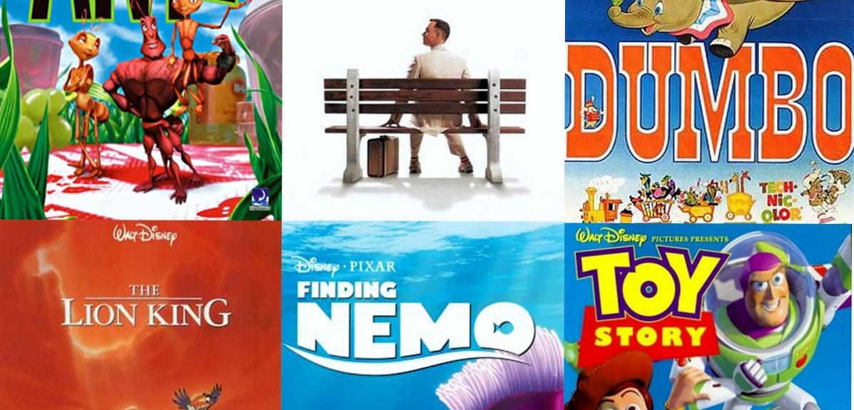
MOVIES -GIFS
SEARCH
Orlando
Andrey
Fernando
This Photo by Unknown Author is licensed under CC BY-SA
Notes:
Good Morning Everybody! Welcome to our presentation of our project Movie-Gifs Search. We came out to this idea for we believed that there’s a need of an inexpensive online video and streaming world wide. Based on statistics 95% of Saudi Arabian users are using online video and streaming as entertainment. In this application, we used new technologies that are available to web developers. To store our data we used the two Firebase cloud database: Firebase Realtime database and cloud Firestore database. Cloud Firestore Database is more flexible and faster , the newer of the two. We integrated three API’s OMDB, Giphy, and YouTube plus a bonus IMDB, in which users can watch movie previews. For styling we utilized materialized by google and some Bootstrap. In addition, we included a sign up for users to gauge users interest and gain revenues. Maybe as we progress, we will build user’s profile wherein they can store their favorite movies or gifs.

Slide 3
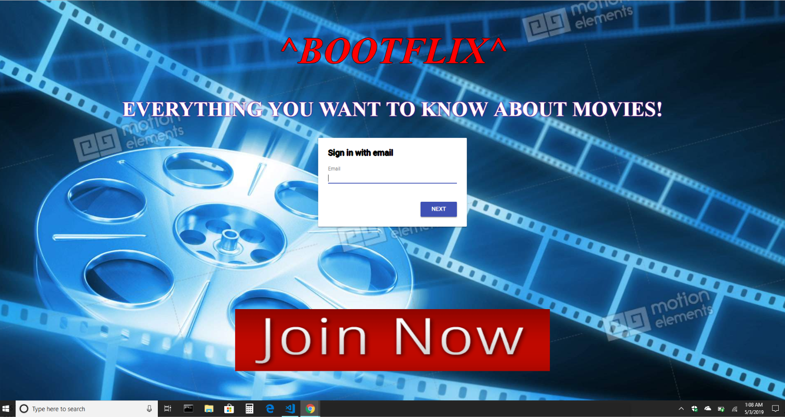

Slide 4
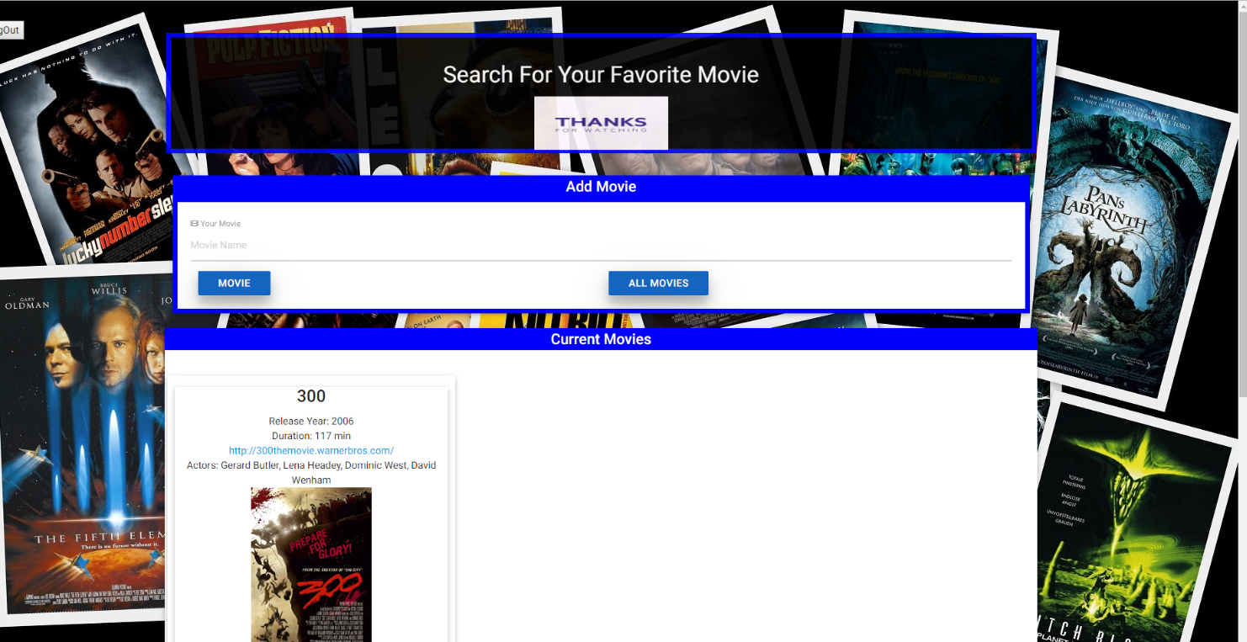
CONTENTS
INTRODUCTION
DESCRIBING THE TECHNICAL PROJECT
DESCRIPTION
MOTIVATION
RESULTS
TEAM EFFORTS
INDIVIDUAL RESPONSIBILITIES
CHALLENGES
IMPROVEMENTS
PART 2 DEMONSTRATION
MOVIE SEARCH
GIFS SEARCH
YOUTUBE
SIGN UP FORM
CONCLUSION
Notes:
There’s two part of this presentation. Describing the Technical Project and demonstration how the applications work. Movie search Gifs Search YouTube and IMDB. The second part of the presentation will be presented by our colleague Andrey.

Slide 5
DESCRIBING THE TECHNICAL PROJECT
DESCRIPTION
Our application benefits movie enthusiasts(users)and general public to search movies by name and watch the results: previews and gifs for free.
MOTIVATION
Our idea is how can we deliver to movie goers and the general public a free and ease of searching movie previews, gifs and information of their favorite movie.
RESULTS
Integrating the four(4) API’s: OMDB, TMDB, YouTube , Giphy and Firebase Cloud Firestore Database were able to build an apps that benefits users for free.
TEAM EFFORTS
Andrey was responsible for writing the database codes and checking code errors to make sure that the functionality is working. Fernando was responsible for the styling using the materialize.css. I was responsible for technical writing and building the MVP. Fernando and I were responsible for coding the Firebase authentication.
Notes:
Users can access the application in any mobile devices at home or in the road anytime and watch their favorite gifs ad movie trailers.
With this in mind, we build a Minimum Viable Product base on our ideas and created this application with inspiration that we can deliver a convenient and free online movie search and watch gifs.

Slide 6
DESCRIBING THE TECHNICAL PROJECT
Individual Responsibilities
Challenges
We realized that using Firebase Realtime Database parallel with Cloud Firestore Database will give us errors when running the application. Using materialize.css was a struggle for us that it affects our styling, so we combined bootstrap.
Improvements
In the future,

Slide 7
MINIMUM VIABLE PRODUCT
Market Research
Is there a need of this product?
How can we make this product stand out with our competitors?
Long-Term goals
Map Out Users Journey
Identify users
Identify the Actions
Identify the Story Endings
Pain and Gain Map
Decide What Features to Build
Notes:
Is there a need of this product?
For the past decade or so , there’s tremendous increase of online video and streaming world wide. Based on the current industry data, online and streaming. With the introduction new technologies people tend to watch videos through the web, rather going to the movies. Movie goers now trend to just watch movies at home through the web because it is inexpensive to online video and streaming.
The ease of searching movies this product will stand out with our competitors. The simplicity of the application, we believe that it is more accessible to users.
To make this application accessible to the general public at ease and faster, meaning that each user will be able to use the application with out struggling. Not all users are computer literate, so we intend that all users able to stream with a simple one, two and three clicks.

Slide 8
MINIMUM VIABLE PRODUCT
Map of users journey
Users(actors) | Actions(jobs) | Story Ending
Viewers | Sign up | Watch picked movies/gifs
 | Search movies/gifs
 | Pick movies/gifs
Pain and Gain Map
Pains | Actions | Gains
Trouble searching movies | Search and Watch | Searching movies and watch

Slide 9
MINIMUM VIABLE PRODUCT
Prioritization Matrix
Debate
High Impact
Include in MVP
Low Urgency
High Urgency
Don’t Include in MVP
Low Impact
Revisit

Slide 10
Main Features of the Project
Allows users to search movies by name and see results
Allows users to see YouTube videos related to the movies
Allows users to see info on IMDB
Allows users to see ‘this’ Gifs and have some fun
Firestore save search movies
Firebase Authentication to gauge users’ interests.

Slide 11
Tools Used
Firebase Cloud Firestore Database
Firebase Cloud Realtime Database
OMDB API
YouTube API
Giphy API
Materialize.css by Google
Firebase Authentication

